Slide 1
Ask Me Anything

Slide 2
Announcements/Reminders
Double check the calendar during RRR week.

Slide 3
Join Ed
https://eecs.link/ed -- EECS 101 Ed
https://eecs.link/data-ed DATA 001 Ed

Slide 4
(Serious-ish) Ed Questions

Slide 5
Question
I've struggled in this class and worry about my ability to keep up in future data science courses. Is there still a place or path for me in data science?

Slide 6
Question
How is Data 100 different from CS 61B? Should I take one before the other

Slide 7
Question
I'm taking c88c concurrently with Data 8, and I find the coding part in this class way more interesting than the statistics in Data 8. I plan to take a DS minor, so I wonder if the higher-level DS classes require more statistics or more CS skills.
How different is the data science major from the minor? Should I double-major or just do the minor? My current intended major is Cognitive Science for reference.

Slide 8
Question
I'm trying to minor in data science and plan on taking the data 100 track. What is the difference between data100/python and stat131A&133/R? Also, are there any classes that you reccomend taking for data science electives? What about classes for people who want a career in data science?

Slide 9
Question
As a psychology major, what are entry level data science jobs you'd recommend within psychology research? Are data analysis skills mainly applied to psych research lab setting, or are there other areas such as education psychology or counseling willing to use DS skills?

Slide 10
Question
How different is the data science major from the minor? Should I double-major or just do the minor? My current intended major is Cognitive Science for reference.

Slide 11
Question
https://cdss.berkeley.edu/academics#academicenrichment
https://cdss.berkeley.edu/data-science/student-opportunities
Data Science Discovery

Slide 12
Fun Ed Questions

Slide 13
Question
What are your thoughts on AI's role in GHG emissions?

Slide 14
Question
How did you decide to be a DS professor while balancing research?

Slide 15
Question
what fun things should we do before graduating from Berkeley?!

Slide 16
Question
Are there going to be data c88c stickers? :'D

Slide 17
Question

Slide 18
(Un)solicited Advice

Slide 19
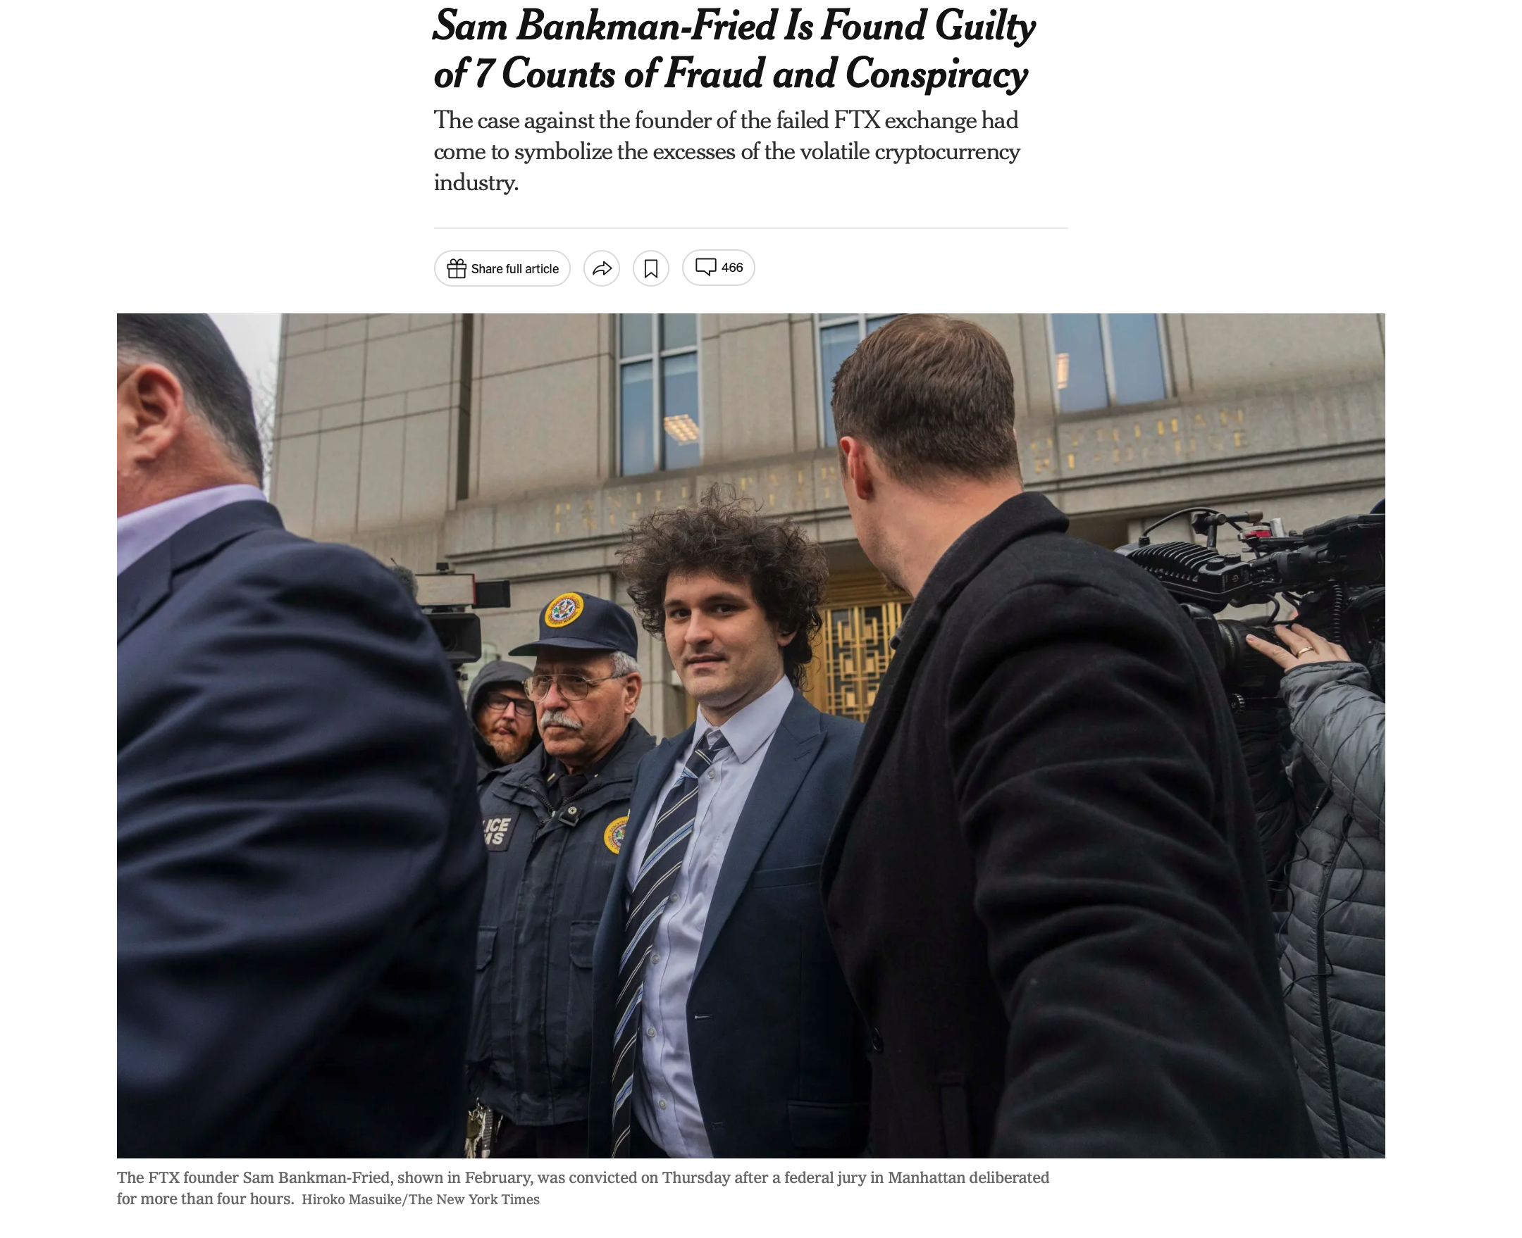
FTX / Careers / Power [NYT]

Slide 20
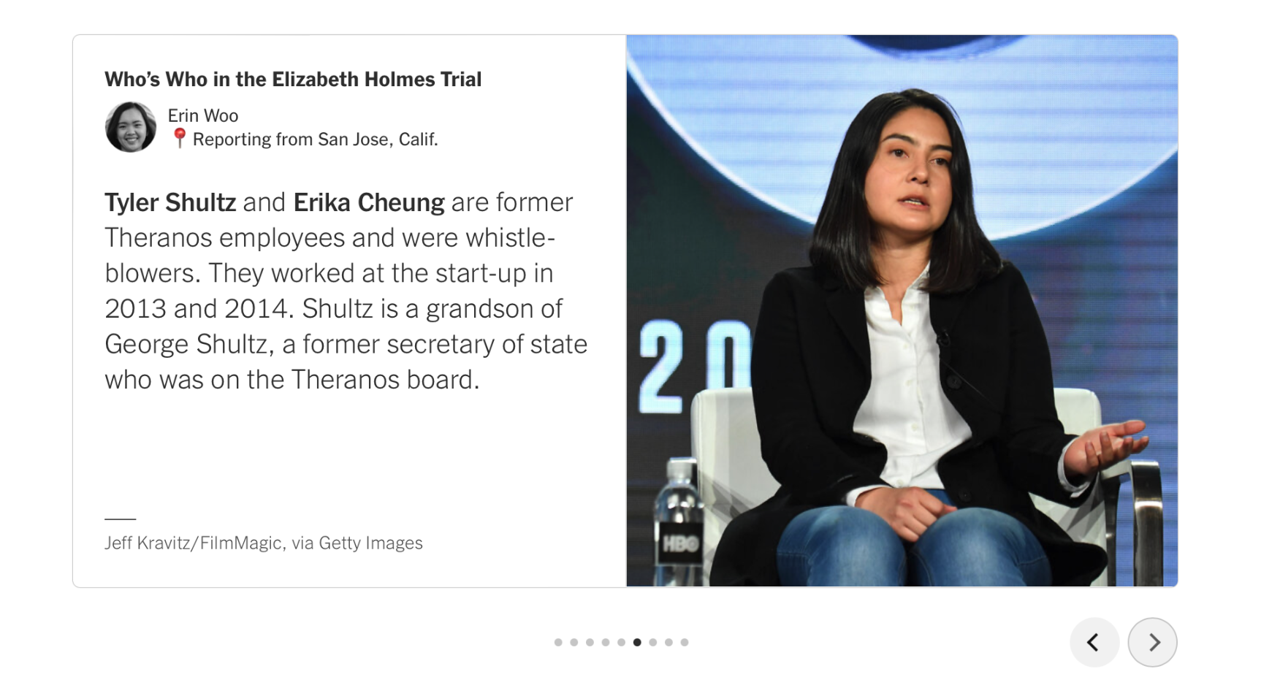
Other Corporate Scandals… Bears doing Good [NYT]

Slide 21
Question

Slide 22
Question

Slide 23
Question

Slide 24
Question

Slide 25
THANK YOU!

Slide 26
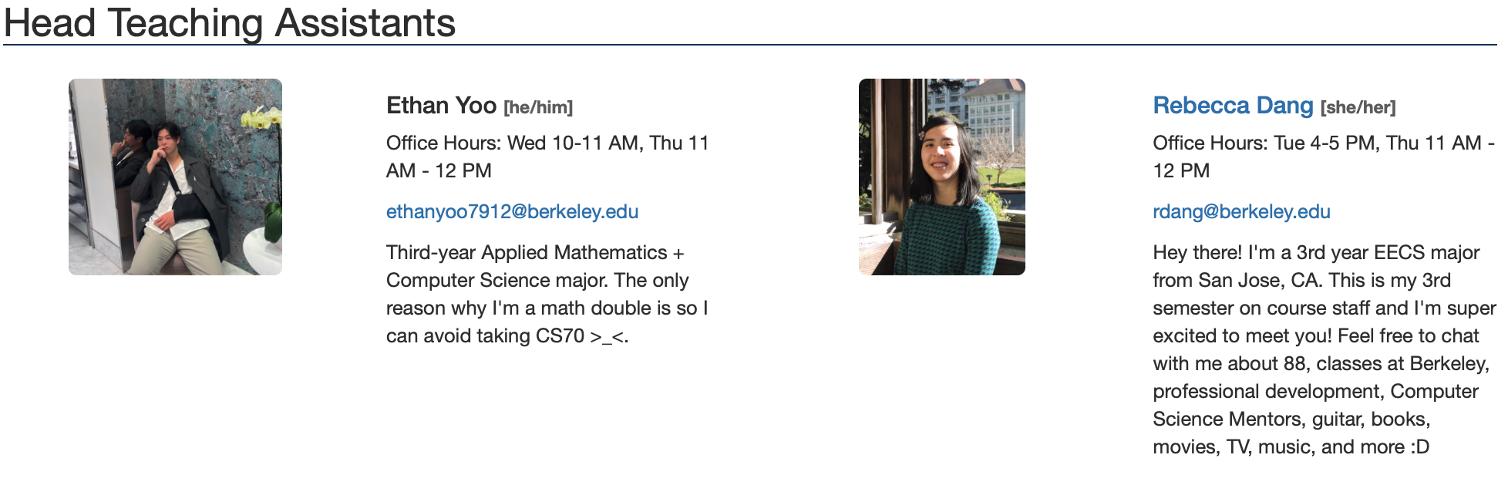
THANK YOU!

Slide 27
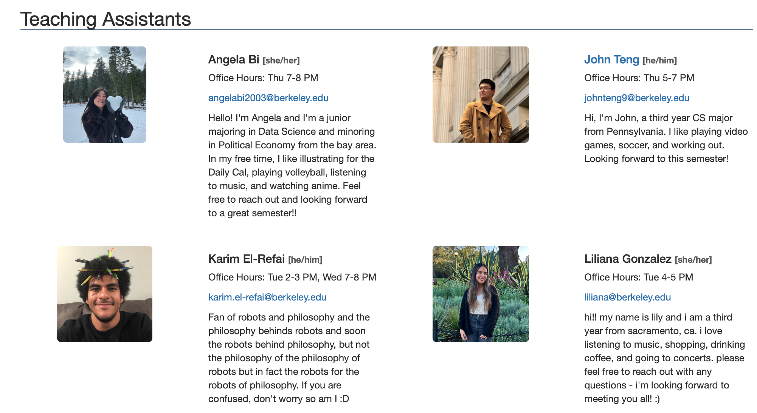
THANK YOU!

Slide 28
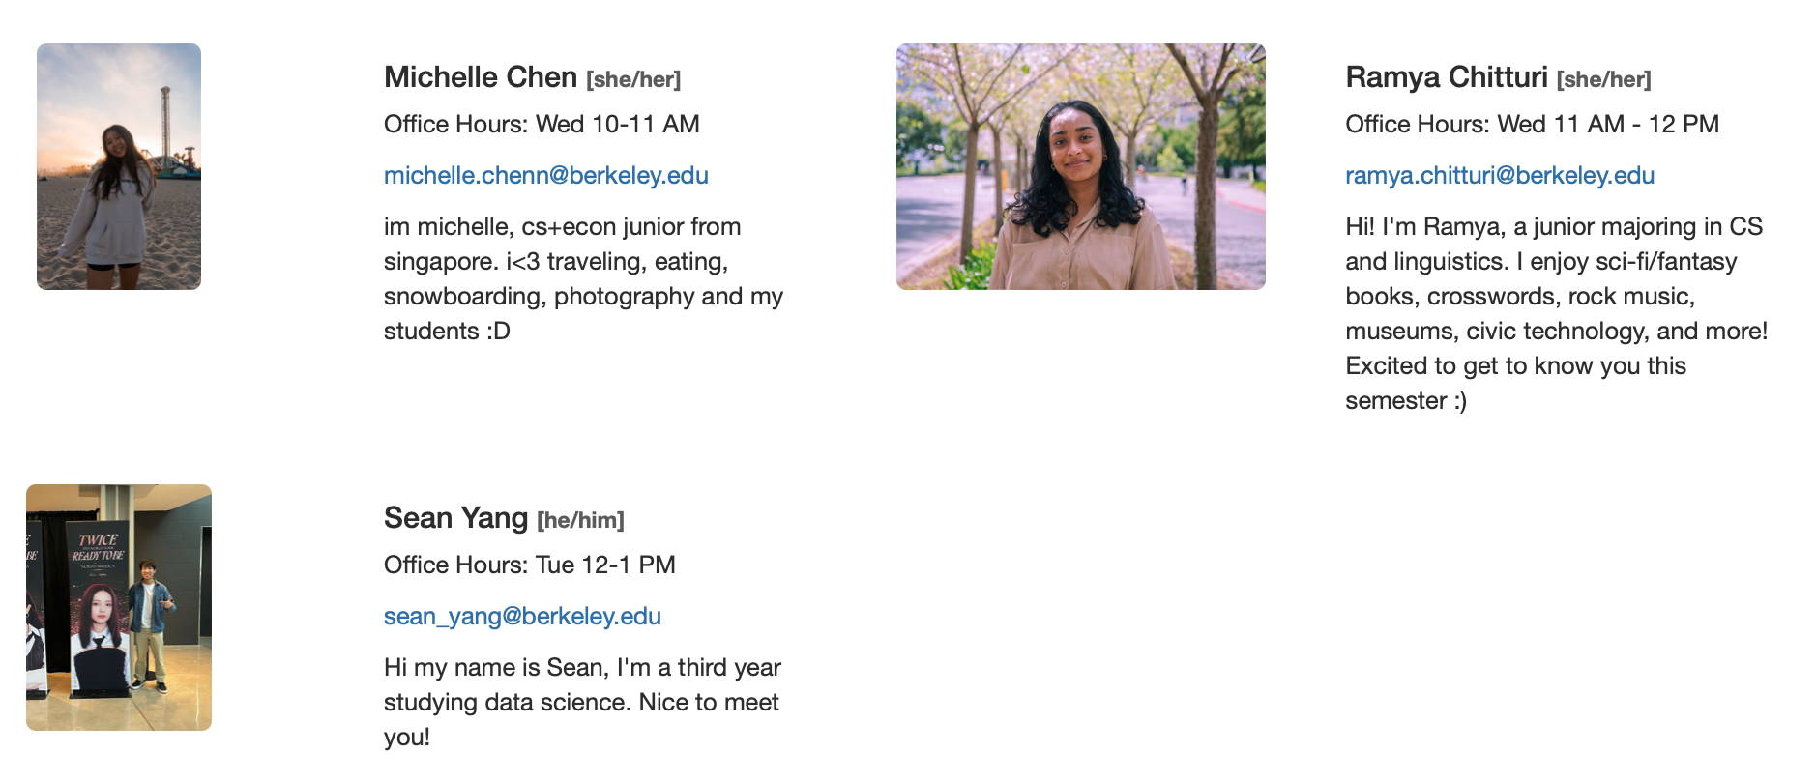
THANK YOU!

Slide 29
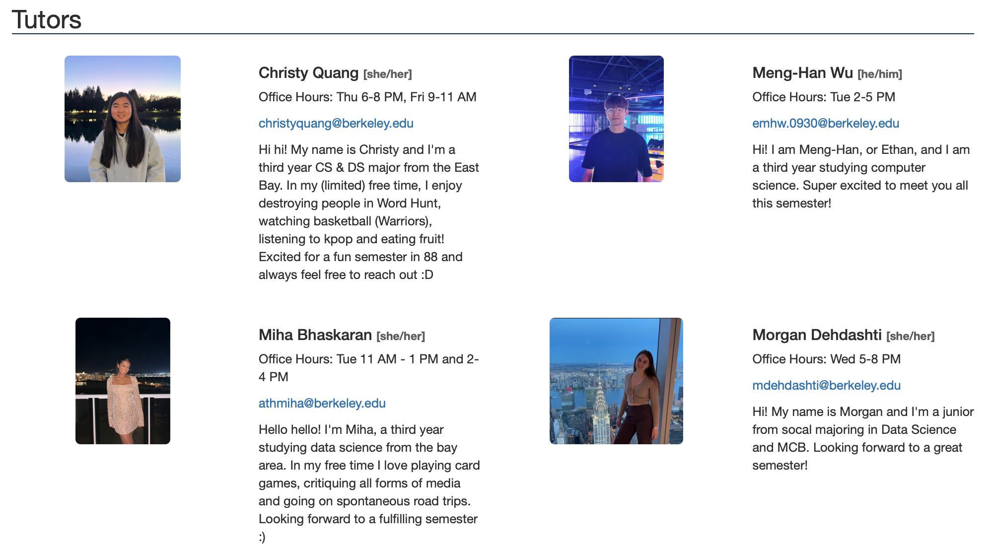
THANK YOU!

Slide 30
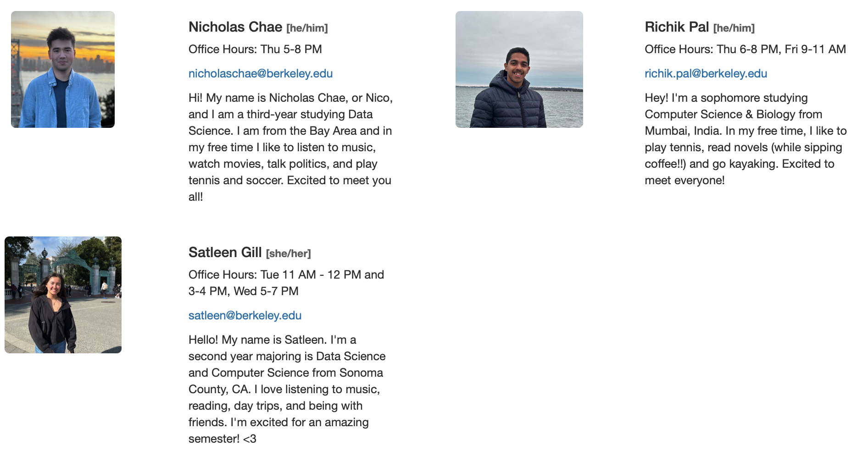
THANK YOU!

Slide 31
Anything Else?

